Slide 1
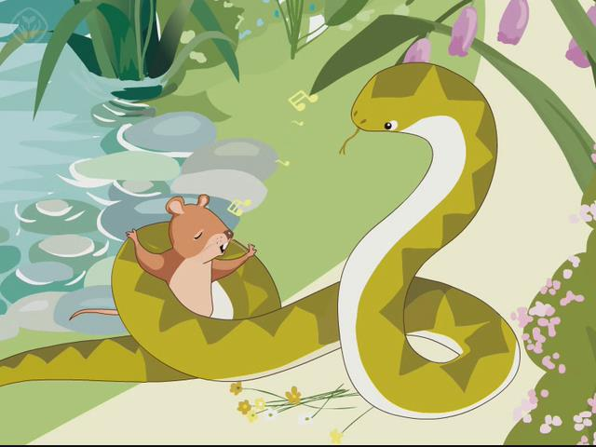
A Rat and A Snake
演讲人：

Slide 2

Snake: I’m hungry. Mmm…
Here comes some tasty
food. Now I can eat.

Slide 3
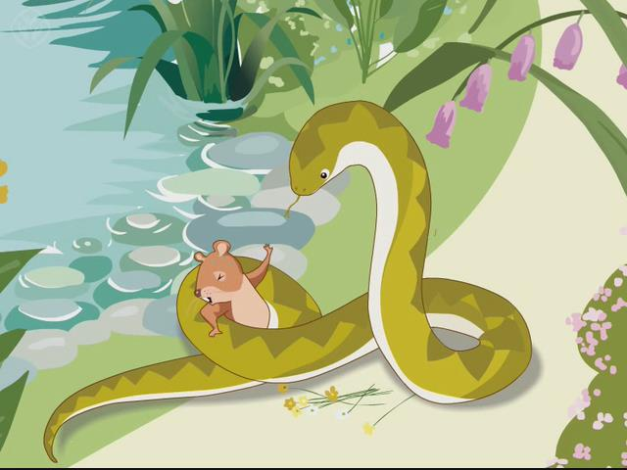
Rat: Dear snake, wait a minute.
I can do things for you.

Slide 4

Snake: Oh! What can you do?
Can you sing?
Rat: Yes, I can.

Slide 5

Snake: Can you dance?
Rat: Yes, I can. Let me go.
Then I can dance for you.

Slide 6
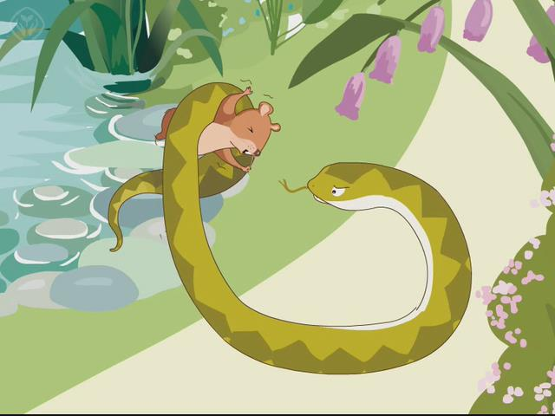
Snake: Let me see. There is a lake
near here. Can you swim?
Rat: No! Don’t throw me into
the lake, please!

Slide 7
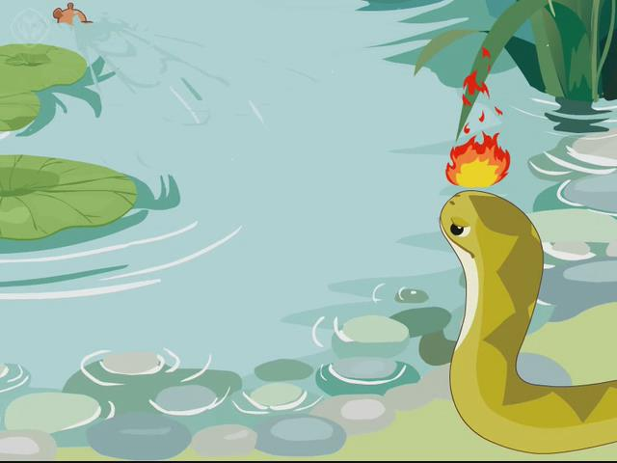
Rat: Haha! Silly snake!
Now I can swim away.
Bye!

Slide 8
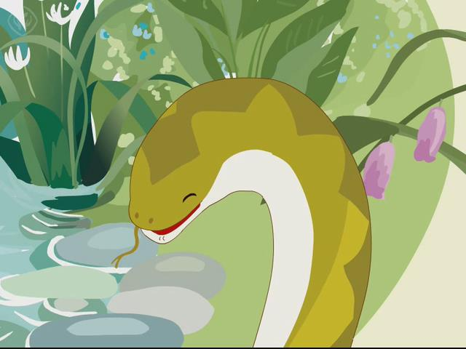
Snake: Really?...

Slide 9
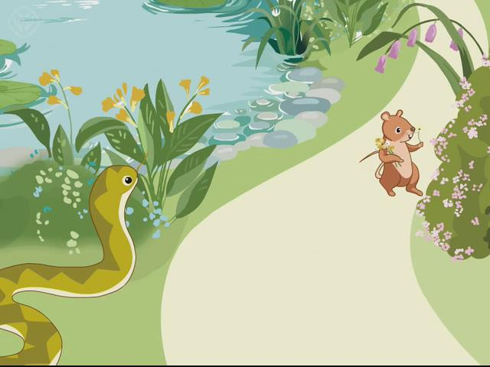
THANK YOU
see you again

